Slide 1

RETAIL INSIGHTS FROM SUPERSTORE DATA
Srinivas Erramalla ,B.TECH 3rd Yr
Avanthi Institute of Engineering and Technology

Slide 2

PROBLEM STATEMENT
The challenge is to analyze a superstore chain's dataset to optimize operations, enhance customer satisfaction, and maximize profitability. This involves understanding consumer behavior, identifying top-selling products and seasonal trends, evaluating supply chain and inventory practices, and providing strategic recommendations for sustained growth and competitive advantage.

Slide 3
Project Description:
Title : Analyzing Consumer Behavior and Operational Efficiency in a Superstore Chain Overview : This project aims to analyze a comprehensive dataset from a superstore chain to gain valuable insights into consumer behavior, product trends, and operational efficiency. By leveraging advanced analytical techniques and tools, the project seeks to uncover patterns and correlations within the data that can drive strategic decisions to optimize profitability and enhance customer satisfaction.

Slide 4
Objectives: 1.Consumer Behavior Analysis: Explore purchasing patterns, customer segmentation, and preferences across different demographics and product categories. 2. Product Trends Identification: Identify best-selling products, seasonal variations, and opportunities for cross-selling or upselling. 3. Operational Efficiency Assessment:.Evaluate inventory management, supply chain performance, and cost-effectiveness of operations. 4. Actionable Insights: Generate actionable recommendations for improving sales strategies, inventory stocking, and operational processes based on data-driven findings.

Slide 5
Methodology:
Data Collection: Gather and clean the superstore dataset, ensuring data integrity and consistency. Exploratory Data Analysis (EDA): Conduct EDA to visualize data distributions, correlations, and outliers. Statistical Analysis : Apply statistical methods to uncover relationships between variables and derive meaningful insights. Machine Learning : Implement predictive models or clustering algorithms to segment customers or forecast demand. Visualization : Create informative visualizations (charts, graphs, dashboards) to present findings effectively.

Slide 6
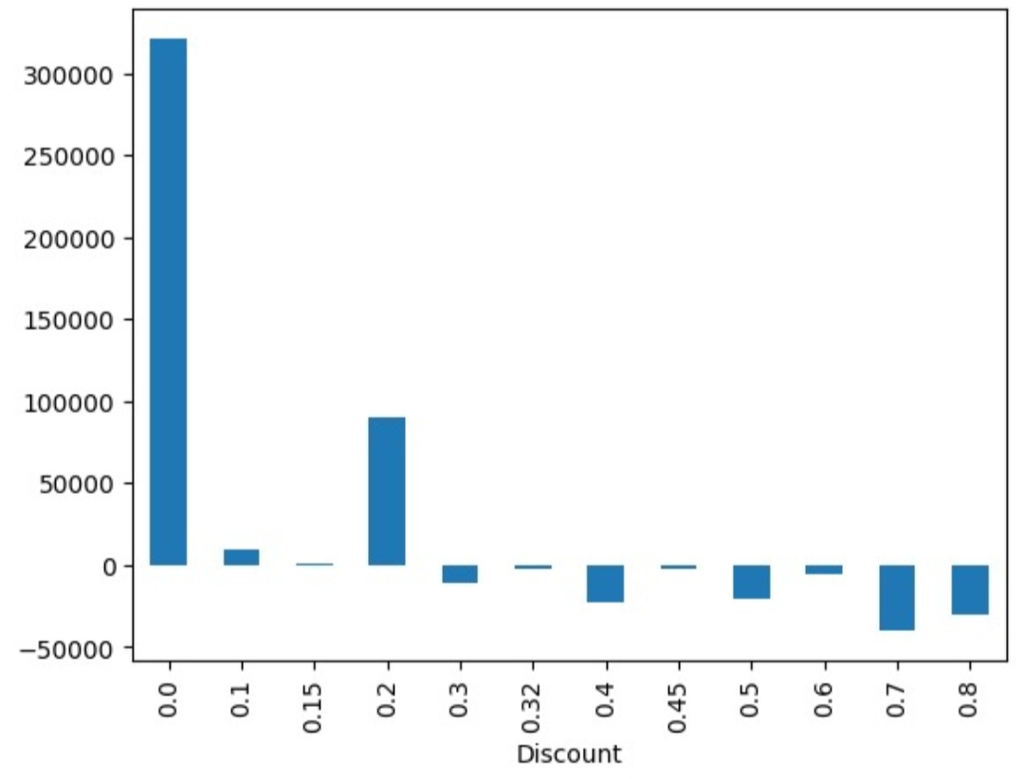
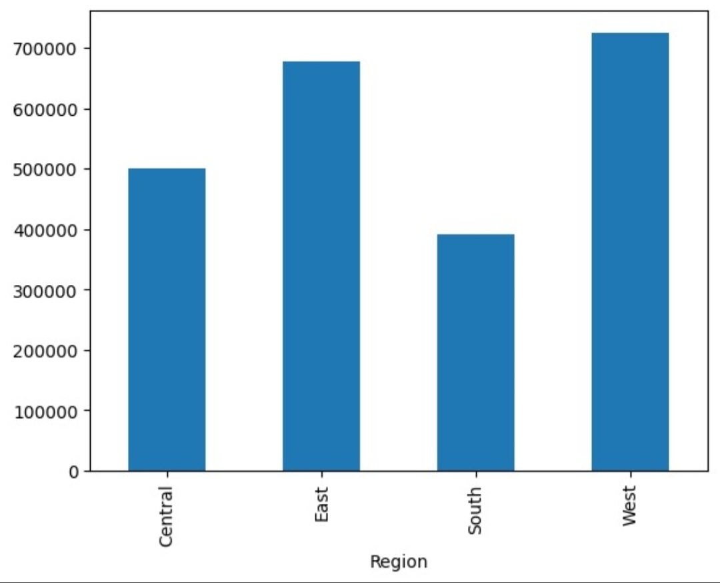
EDA Results:
Region VS Sales
Discount VS Profit

Slide 7
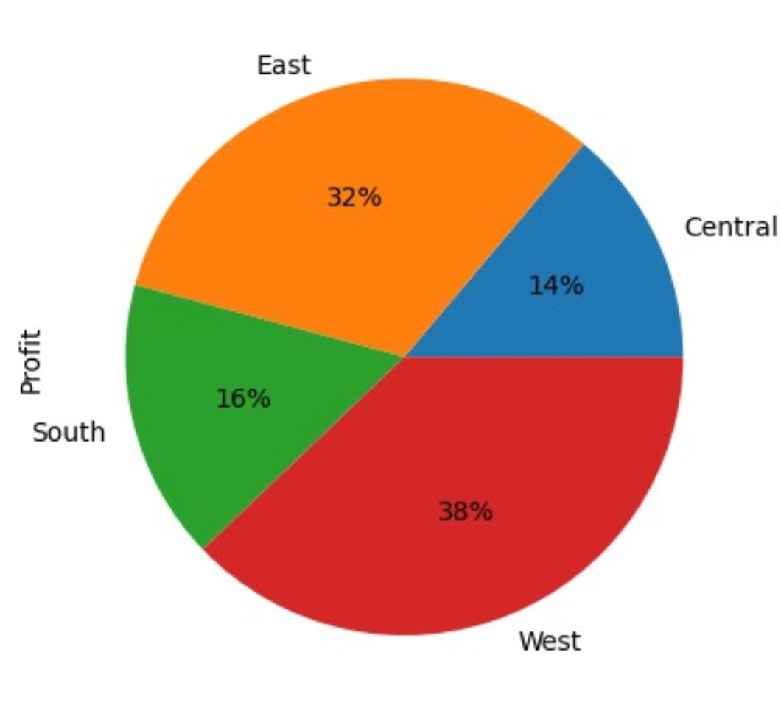
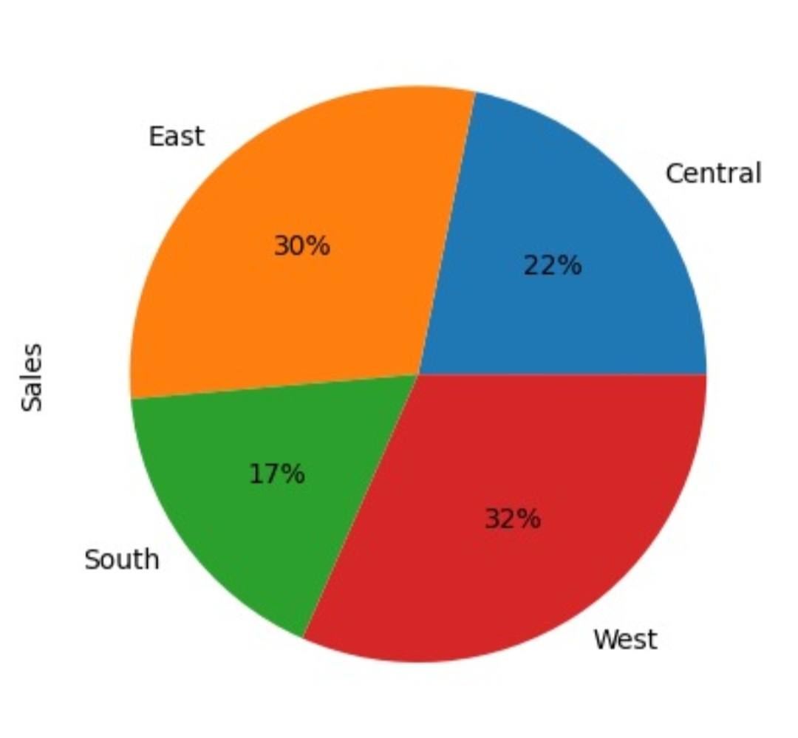
EDA Results :

Slide 8
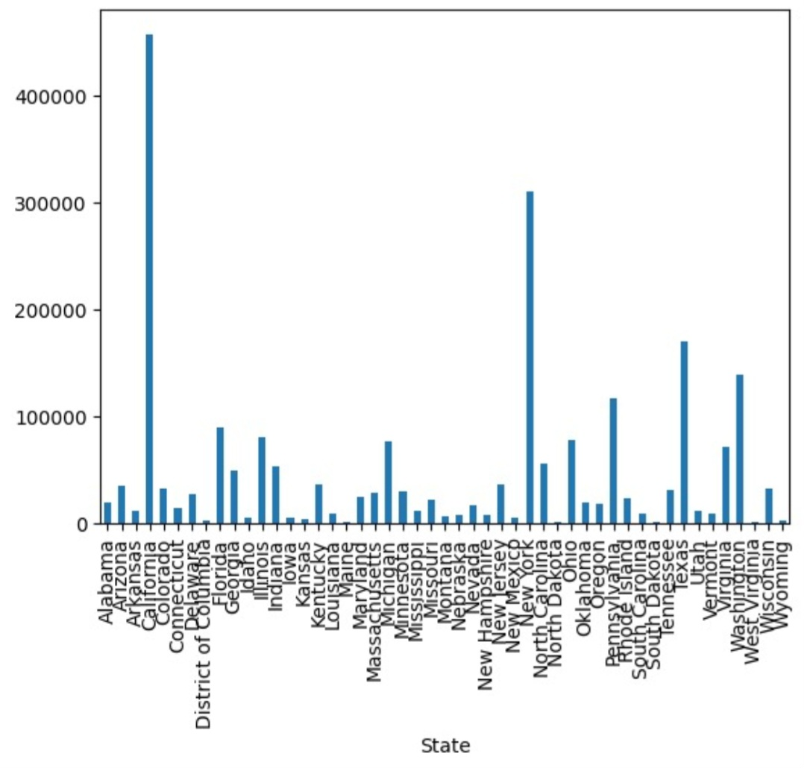
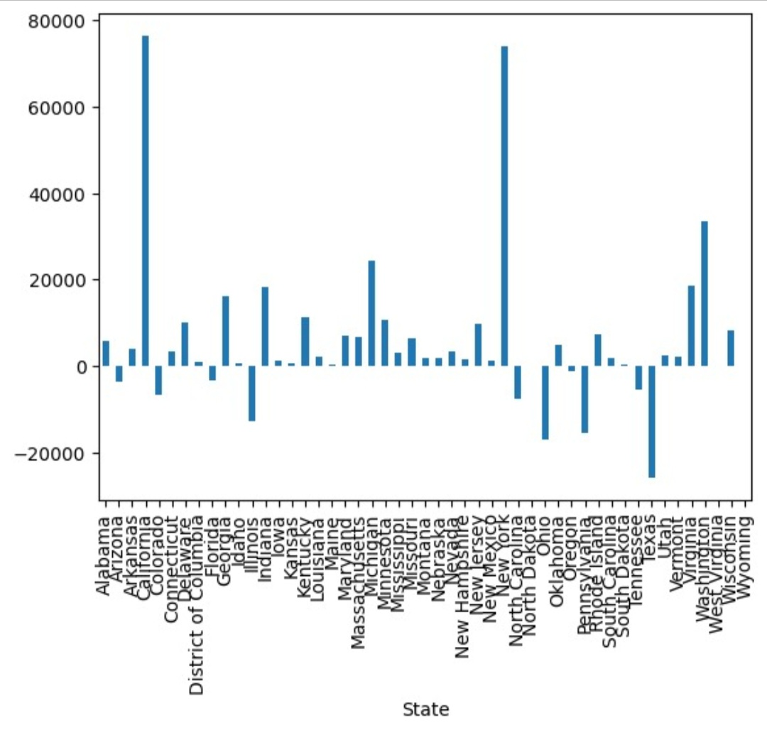
EDA Results:

Slide 9

WHO ARE THE END USERS?
Store Managers
Sales Team
Marketing Team
Supply Chain Managers
Financial Analysts
Customer’s Service Team
Executive Management

Slide 10

Technology Used
The technology used for analyzing Superstore data typically includes a combination of tools and platforms designed for data management, analysis, and visualization.
ETL (Extract, Transform, Load) Tools: Such as Apache Airflow, Talend, or Informatica for extracting data from various sources, transforming it into a usable format, and loading it into data warehouses or databases. Data Analysis Tools: Including Python libraries like Pandas, NumPy, and SciPy for data manipulation and analysis. R programming language for statistical analysis and machine learning algorithms.

Slide 11
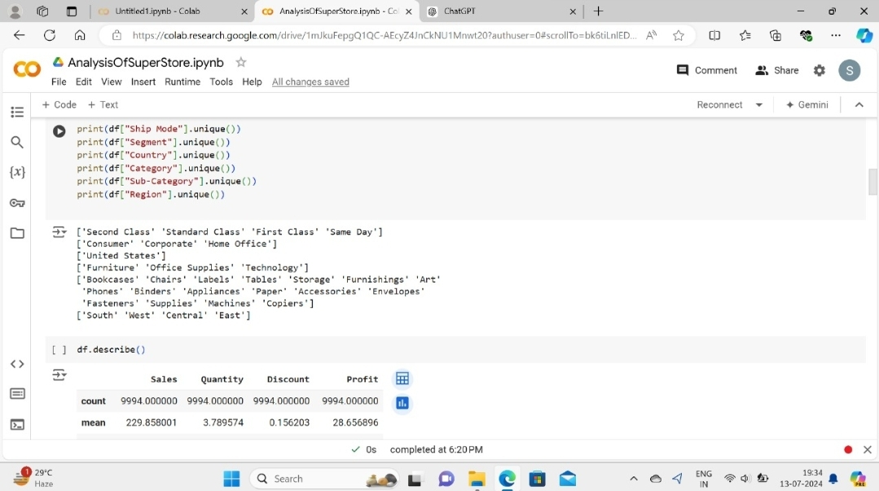
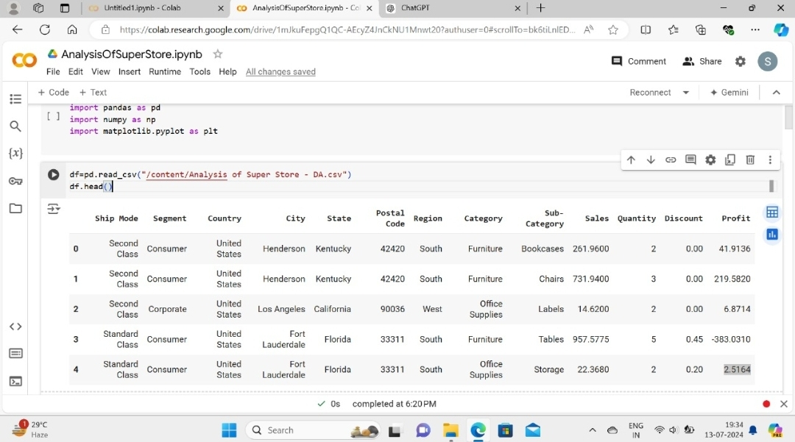
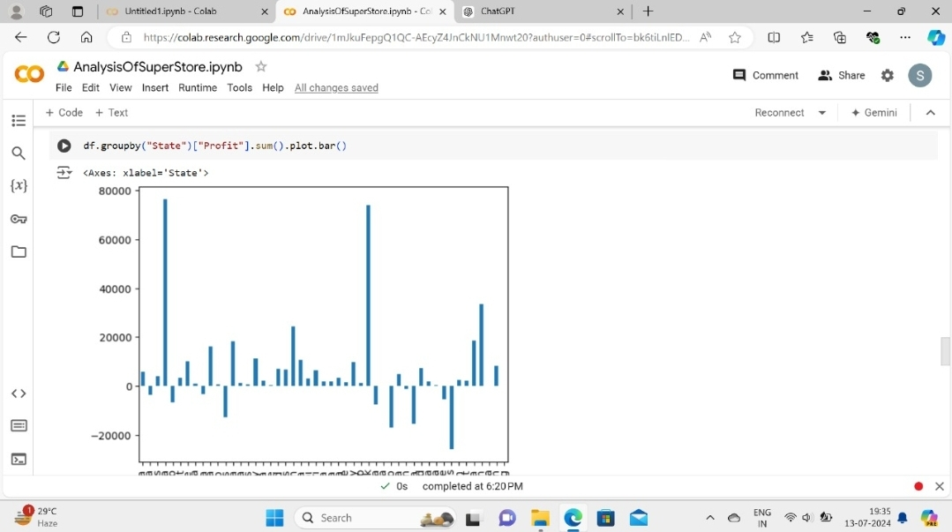
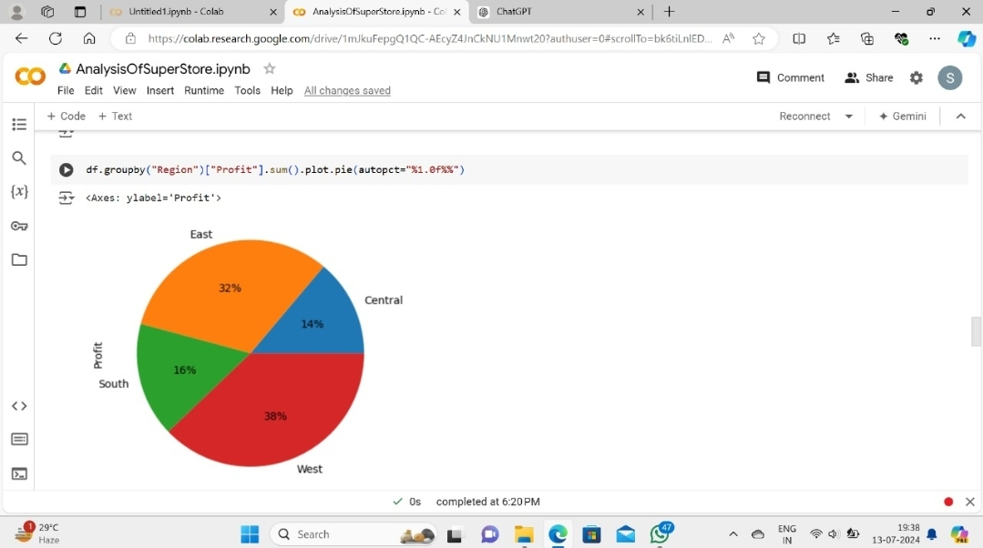
RESULTS

Slide 12
All the code performed on the superstore dataset is here :
https://colab.research.google.com/drive/1mJkuFepgQ1QC-AEcyZ4JnCkNU1Mnwt20?usp=sharing

Slide 13
Thank you
.
.

